Slide 1

DATA-DRIVEN SOLUTIONS FOR PCOS: EXPLORING MACHINE LEARNING IN DIAGNOSTIC PROCESSES

Slide 2
AGENDA OVERVIEW
BACKGROUND OF THE STUDY ML MODELS
ANALYSIS DISCUSSION
STATISTICAL TESTS FUTURE PLAN OF ACTION
Polycystic ovary syndrome, commonly known as PCOS, often comes with a high number of small follicles, resembling cysts, situated just beneath the ovary's surface. These underdeveloped follicles contain eggs.
But first, what is PCOS?

Slide 3

BACKGROUND
1
Fertility challenges
2
Weight changes
3
Menstrual Irregularity
79% of women with PCOS experience fertility challenges.
67% of women with PCOS experience weight changes.
56% of women with PCOS experience irregularity of menstrual cycle.
The syndrome is associated with health risks. These include infertility, metabolic syndrome, and type 2 diabetes. Cardiovascular disease and mental health issues are also associated.

Slide 4
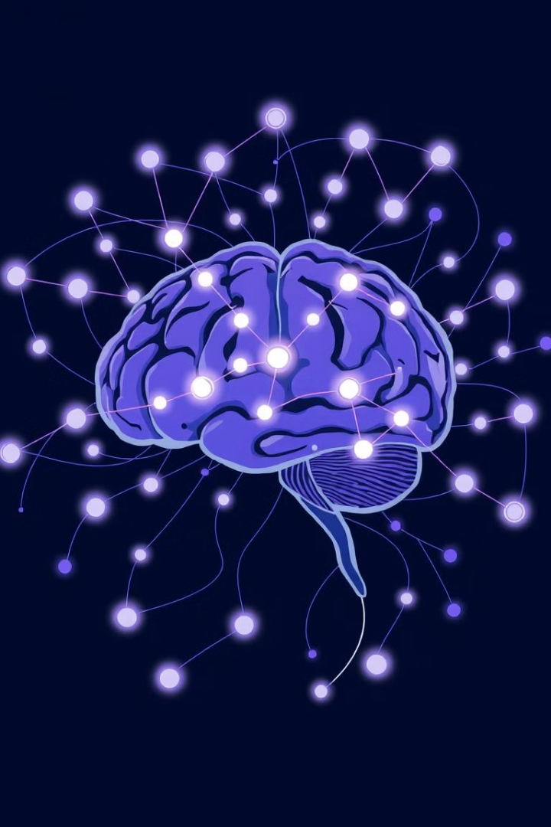
MOTIVATION
Enhanced Pattern Recognition
Personalized Medicine
Automated screening tools provide consistent, objective assessments
Accounts for individual variations in symptoms and risk factors
Addressing Healthcare Disparities
Provides clinicians with valuable decision support tools

Slide 5
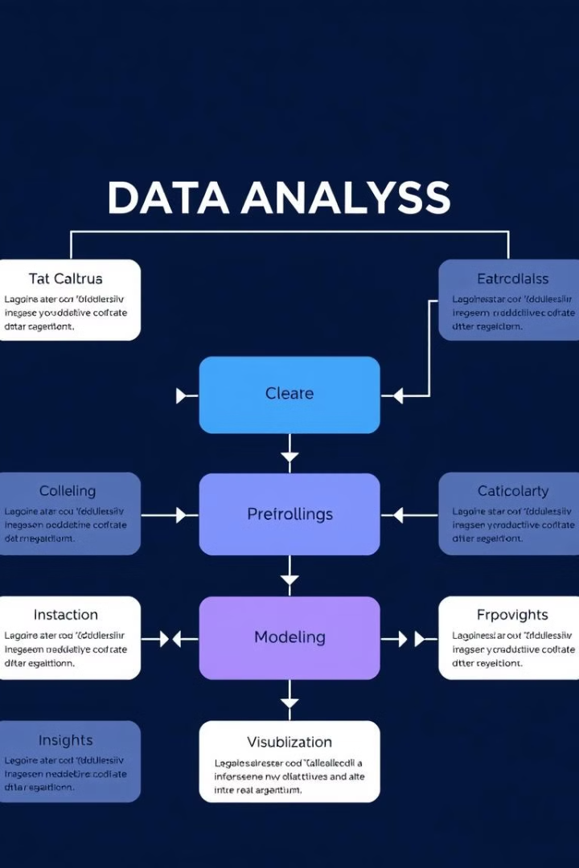
ANALYSIS
This project aims to develop accurate machine-learning models for PCOS prediction using health data. It aims to surpass traditional diagnostics. (ROC AUC 73-100% in previous studies).
This framework provides a structured approach to analyzing PCOS prediction using machine learning. From data preparation to model selection and interpretation that has been used in the project

Slide 6
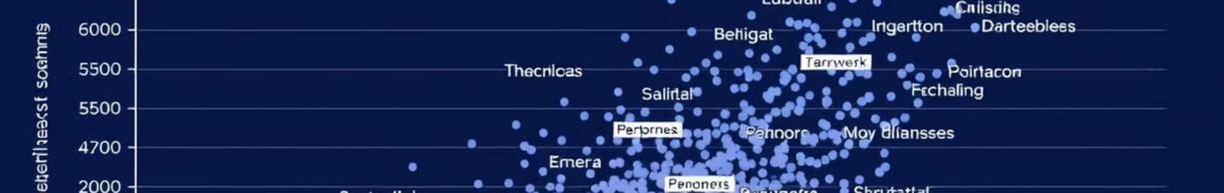
Exploratory Data Analysis
PCOS Prevalence
1
The dataset shows a higher number of individuals without PCOS.
2
Age Distribution
18-25 age group has the highest count of individuals.
Symptom Analysis
3
"Irregular periods" and "Hair thinning" are common symptoms.
Dataset contains information from 267 individuals. It was collected primarily in Mumbai and surrounding areas in India. The dataset includes both PCOS-positive and PCOS negative cases.

Slide 7
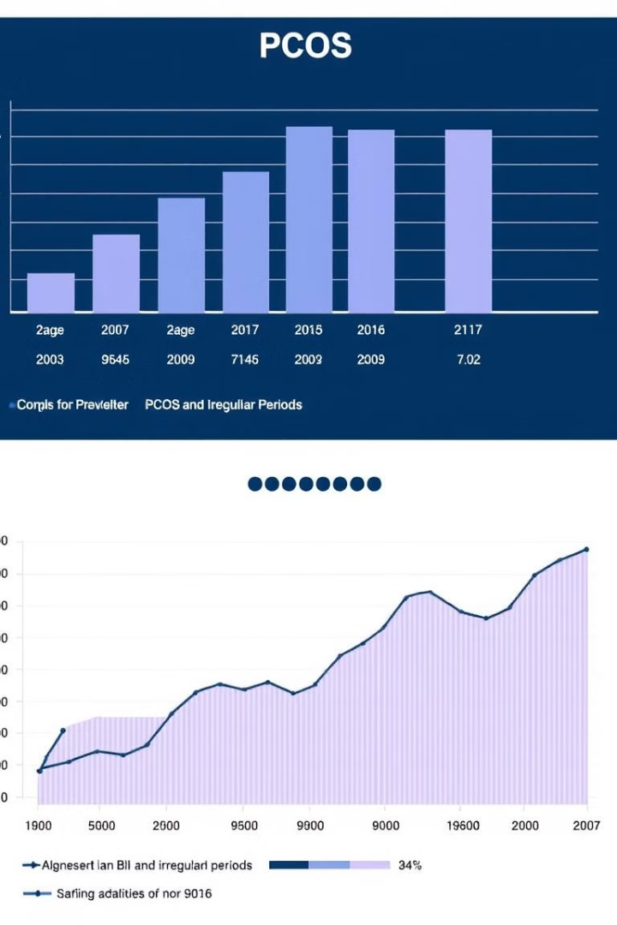



STATISTICAL ANALYSIS
Exercise frequency
No significant difference found between groups (p > 0.05).
Eating Out frequency
No significant difference found between groups (p > 0.05).
Overweight
Significant association found (p < 0.05).
Conducted T-tests and Chi-Square tests on lifestyle factors and symptoms. Showed significant associations. These include between being overweight and PCOS.

Slide 8



MACHINE LEARNING APPROACH
Handle
2
Missing values with median/mode.
Prepare
1
Encode categorical variables.
Evaluate
3
Performance using accuracy metrics.
Prepared the data for machine learning models: Encode categorical variables. Evaluate model performance using metrics like accuracy, precision, recall, and F1-score.

Slide 9
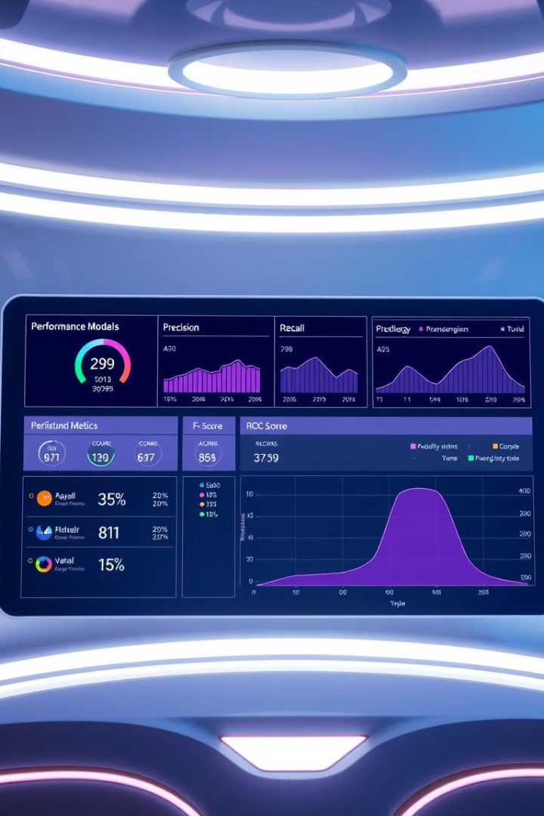
Model Performance
Metric
Logistic Regression
SVM
Naive Bayes
Decision Tree
Accuracy
0.851852
0.814815
0.870370
0.833333
Precision
0.833333
0.625000
0.727273
0.636364
Recall
0.416667
0.416667
0.666667
0.583333
F1-Score
0.555556
0.500000
0.695652
0.608696
ROC-AUC
0.811508
0.575397
0.847222
0.716270
Naive Bayes: Best overall performer; Logistic Regression: Strong all-around performance; Decision Tree: Balanced performance; SVM: Underperformed compared to other models.

Slide 10
References
Barrera, F. J., Brown, E. D. L., Rojo, A., Obeso, J., Plata, H., Lincango, E. P., Terry, N., Rodríguez-Gutiérrez, R., Hall, J. E., & Shekhar, S. (2023). Application of machine learning and artificial intelligence in the diagnosis and classification of polycystic ovarian syndrome: a systematic review. Frontiers in endocrinology, 14, 1106625. https://doi.org/10.3389/fendo.2023.1106625
Elmannai, H., El-Rashidy, N., Mashal, I., Alohali, M. A., Farag, S., El-Sappagh, S., & Saleh, H. (2023). Polycystic Ovary Syndrome Detection Machine Learning Model Based on Optimized Feature Selection and Explainable Artificial Intelligence. Diagnostics (Basel, Switzerland), 13(8), 1506. https://doi.org/10.3390/diagnostics13081506
Rasquin, L. I., Anastasopoulou, C., & Mayrin, J. V. (2022, November 15). Polycystic ovarian disease. In StatPearls [Internet]. Treasure Island (FL): StatPearls Publishing. Available from https://www.ncbi.nlm.nih.gov/books/NBK459251/
THANK YOU

